Slide 1

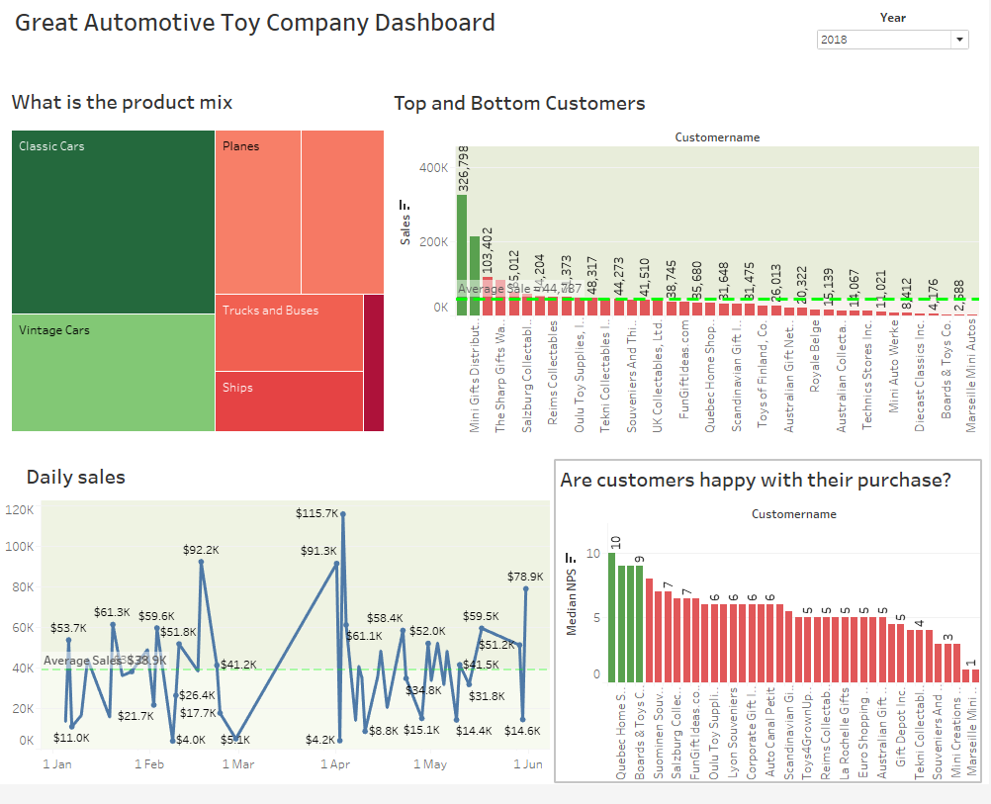
Great Automotive Toy Company
Dashboard

Slide 2
Great Automotive Toy Company
Reasons for selecting charts on Dashboard
The line chart shows the sales over the 3 year period and was selected because it best captures sales data series over time. The treemap shows the product categories and their total numbers annually and was selected because it shows composition of the company product and their relative proportions. The vertical bar chart show the top and bottom customers of the business and are useful for comparing different customers by sales. Top customers are in green, bottom are in red colours. The final vertical bar shows the median NPS score and shows who are the promoters and detractors. Detractors are in colour red and promoters in green.

Slide 3
Great Automotive Toy Company
KPIs
Overall revenue can be measured by
Net Revenue Churn Rate
Revenue by Product
Sales mix
Sales Growth by Product Type
Return on Investment
Geographic performance
Sales Volume by Location
On-time Delivery
Weakest customer performance (bottom three)
Customer Lifetime Value
Revenue per Customer

Slide 4
Great Automotive Toy Company
Smart Objectives
Overall revenue
Increase Revenue Growth Rate to 50% for the year
Reduce Customer Churn Rate by 10% for the year
Sales mix
Increase sales of train toys by 20% for the year
Increase revenue by product by 10% for the year
Geographic performance
Increase sales volume per location by 10% for the year
Ensure 90% on-time delivery for the year
Weakest customer performance (bottom three)
Provide 10% discounts for large orders
Increase revenue per customer by 10% for the year

Slide 5
Great Automotive Toy Company
NPS Calculation
NPS score is -40%. Most of the customers are unhappy with the products and services offered by the company

Slide 6
Great Automotive Toy Company
Revenue Churn Rate
Quarter 2 revenue churn = total revenue at the end quarter 2 – Total revenue at the end of quarter 1
Quarter 2 gross revenue churn = (833,731 – 766,261)/ 833,731 = 0.08 *100 = 8%
This means the company lost 67,470 or 8% in revenue between quarter 2 and quarter 3

Slide 7
Great Automotive Toy Company
Cancellation Rate
Order Cancellation Rate = number of cancelled order/ total number of orders
Order Cancellation Rate = 60/2823 = 0.02
This means that 2% of the orders were cancelled.

Slide 8
Great Automotive Toy Company
Revenue Lost Due to Cancellation
Revenue lost due to cancellation = 194,487.48

Slide 9
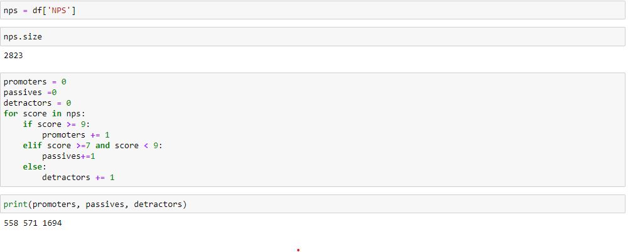
Great Automotive Toy Company
Appendix: Calculations done using python-pandas library

Slide 10
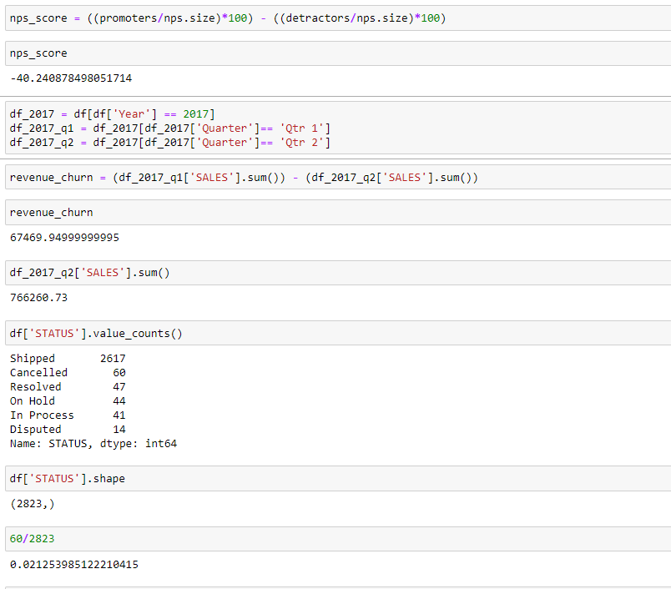
Great Automotive Toy Company
Appendix: Calculations done using python-pandas library

Slide 11
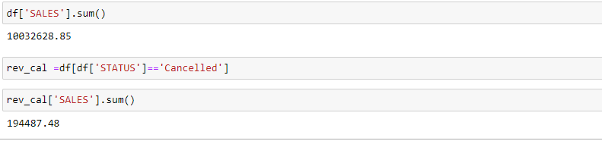
Great Automotive Toy Company
Thank you

